Slide 1
Artificial Intelligence CS-511
Modified slides of Prof. M. Batouche, KSU, and AI course on Udacity.

Slide 2
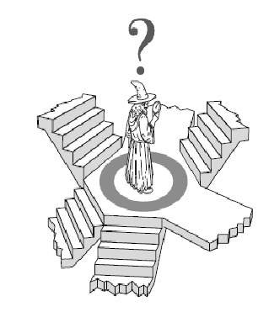
Adversarial Search
Minimax, α-β pruning

Slide 3
MAEs and Games
Multi-agent environment: every agent needs to consider the actions of the other agents, in order to optimize its own welfare
Normally considered in terms of economies
Cooperative: Agents act collectively to achieve a common goal
Competitive:
Agents compete against each other
Their goals are in conflict
Gives rise to the concept of adversarial search problems – often known as games.

Slide 4
Game Theory
It’s a branch of economics
Views any MAE as a game provided that the impact of each agent on the other is “significant”, i.e., able to affect the actions of the other agent(s)
In AI, “game” is a specialized concept:
Deterministic, fully-observable environments
Two agents whose actions must alternate
Utility values at the end of the game are always equal and opposite
+1 = Chess winner
-1 = Chess looser.

Slide 5
AI Games
Tackled by Konrad Zuse, Claude Shannon, Norbert Wiener, Alan Turing
Have seen lot of successes recently, e.g., DeepBlue
Game states are easy to represent:
Agents restricted by a limited action rules
Outcomes defined by precise rules
Games: interesting because they are hard to solve:
Chess: average branching factor of 35
If 50 moves by each player, search tree has 35¹⁰⁰ nodes!

Slide 6
Games vs. Search problems
In typical search problems, we optimize a measure to acquire the goal: there is no opponent
In games, there is an "Unpredictable" opponent
Need to specify a move for every possible opponent reply Strict penalty on an inefficient move
Stringent time constraints
Unlikely to find goal, must approximate
Requires some type of a decision to move the search forward.

Slide 7
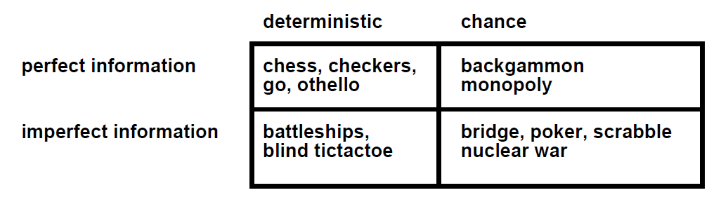
Types of Games

Slide 8
Game Formulation
Initial state
Successor function
Terminal state test
Utility function: defining the usefulness of the terminal states from the point of view of one of the players.
Imagine 2 players of tic-tac-toe: MAX and MIN
MAX moves first: We can generate a game tree
The terminal states are at the leaves
MAX should play in order to maximize its utility, which will minimize the utility for MIN
This is called a Zero-Sum Game.

Slide 9
Utility function
For Tic-Tac-Toe, the function could be as simple as returning:
+1 if the computer wins
-1 if the player wins
0 otherwise.
However, this simple evaluation function may require deeper search.

Slide 10
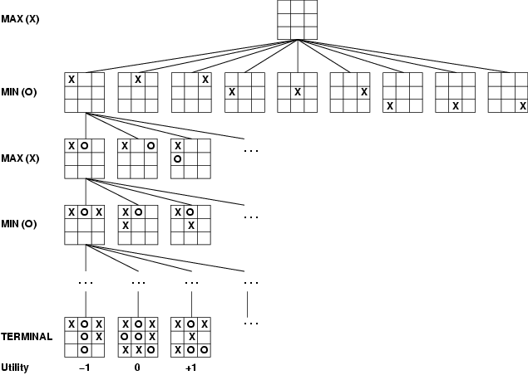
Game tree
2-player, deterministic, fully observable
This terminal state is one of the worst for MAX and one of the best for MIN
This terminal state is one of the best for MAX and one of the worst for MIN

Slide 11
Perhaps a better utility function?
+100 for EACH 3-in-a-line for computer.
+10 for EACH 2-in-a-line (with a empty cell) for computer.
+1 for EACH 1-in-a-line (with two empty cells) for computer.
Same negative scores for opponent, i.e.,
-100 for EACH 3-in-a-line
-10 for EACH 2-in-a-line
-1 for EACH 1-in-a-line.
0 otherwise (empty lines or lines with both computer's and opponent's seed).
Compute the scores for each of the 8 lines (3 rows, 3 columns and 2 diagonals) and obtain the sum.

Slide 12
Optimal Strategy For MAX
This is a MAE
In discovering the sequence of optimal moves by MAX, we have to consider that MIN is taking moves as well
So, the optimal strategy will tell how should MAX play against MIN (by considering the moves of the latter), in order to win the game
Let us consider a shortened game tree of TIC-TAC-TOE
Numbers are the utilities
Ply: a move by MAX followed by a move from MIN.

Slide 13
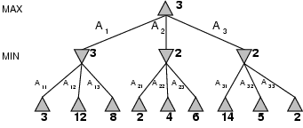
Shortened Game Tree
Move of MAX
Move of MIN

Slide 14
Minimax
When it is the turn of MAX, it will always take an action in order to maximize its utility, because it’s winning configurations have high utilities
When it is the turn of MIN, it will always take an action in order to minimize its utility, because it’s winning configurations have low utilities
In order to implement this, we need to define a measure in each state that takes the move of the opponent into account:
This measure is called Minimax.

Slide 15
Minimax
Minimax represents the utility of a state, given that both MAX and MIN will play optimally till the end of the game
In any state s, one or more actions are possible
For every possible new state that can be transited into from s, we compute the minimax value
The term “Minimax” is used because:
the opponent is always trying to minimize the utility of the player, and
the player is always trying to maximize this minimized selection of the opponent.
Confused? See next slide…..

Slide 16
Minimax
Consider “3” at Level 1: MIN selects an action (A11) that leads to a state of minimum utility for MAX, i.e., minimum{3,12,8}
Consider “3” at Level 0: MAX selects an action (A1) that leads to a state of maximum utility for MIN, i.e., maximum{3,2,2}
Both are opposing what is best for the other.

Slide 17
Minimax
At each node, MAX will always select the action with highest minimax value (it wants to reach states with higher utilities)
At each node, MIN will always select the action with lowest minimax value (it wants to reach states with lower utilities).

Slide 18
Minimax algorithm
Minimax (player, board)
if(game over in current board position)
return winner
children = all legal moves for player from this board
if(max's turn)
return maximal score of calling minimax recursively
on all the children
else (min's turn)
return minimal score of calling minimax recursively
on all the children

Slide 19
Minimax algorithm
minimax(depth, player)
if (gameover || depth == 0) return score
children = all legal moves for this player
if (player is computer, i.e., max)
bestScore = -inf
for each child
score = minimax (depth - 1, opponent)
if (score > bestScore) bestScore = score
return bestScore
else (player is opponent, i.e., min)
bestScore = +inf
for each child
score = minimax(depth - 1, computer)
if (score < bestScore) bestScore = score
return bestScore
// Initial Call
minimax (2, computer)

Slide 20
Minimax algorithm
function integer minimax (node, depth)
if node is a terminal node or depth <= 0:
return the heuristic value of node
v := -∞
// evaluation is identical for both players
for child in node:
v := max(v, -minimax (child, depth - 1))
return v

Slide 21
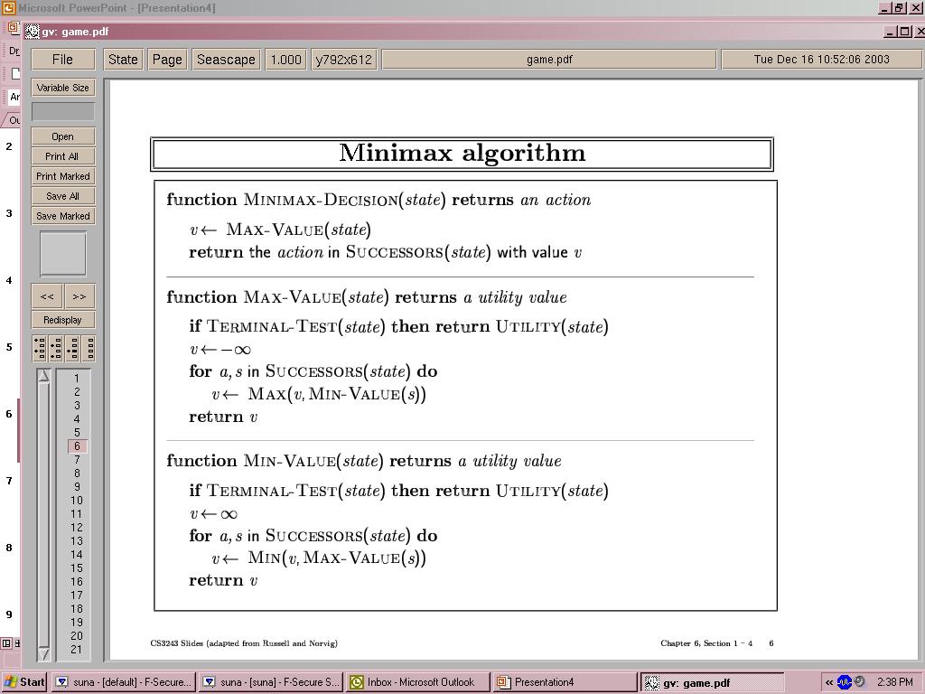
Minimax algorithm
Depth-First Exploration
Recursion: Winds all the way to the terminal nodes, and then unwinds back by backing up the values
Min(minimax) for MIN moves
Max(minimax) for MAX moves

Slide 22
Properties of Minimax
Complete? Yes (if tree is finite)
Optimal? Yes (against an optimal opponent)
Time complexity? O(b^{m})
Space complexity? O(bm) (depth-first exploration)
For chess, b ≈ 35, m ≈100 for "reasonable" games → exact solution completely infeasible
We need to think of a way to cut down the number of search paths.

Slide 23
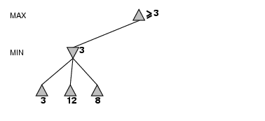
α-β pruning example
MINIMAX (root )=max(min(3, 12, 8), --- , ---- )
= max(3, --- , ---)

Slide 24
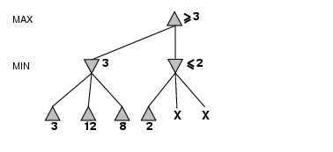
α-β pruning example
MINIMAX (root )=max(min(3, 12, 8), min(2, x, y), ---)

Slide 25
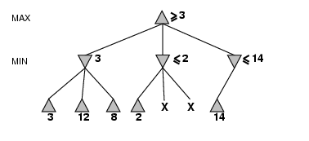
α-β pruning example
MINIMAX (root )=max(min(3, 12, 8), min(2, x, y), min(14, -, -))

Slide 26
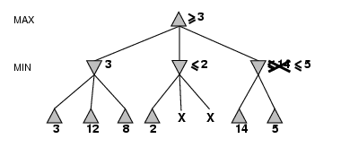
α-β pruning example
MINIMAX (root )=max(min(3, 12, 8), min(2, x, y), min(14, 5, -))

Slide 27
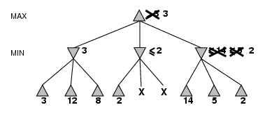
α-β pruning example
MINIMAX (root )=max(min(3, 12, 8), min(2, x, y), min(14, 5, 2))
= max(3, min(2, x, y), 2)
= max(3, z, 2) where z = min(2, x, y) ≤ 2
= 3.

Slide 28
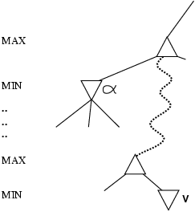
Why is it called α-β?
α is the value of the best (i.e., highest-value) choice found so far at any choice point along the path for MAX
If v is worse than α, MAX will avoid it
→ prune that branch
Define β similarly for MIN.

Slide 29
The α-β algorithm
minimax(level, player, alpha, beta)
if (gameover || level == 0) return score
children = all valid moves for this "player"
if (player is computer, i.e., max's turn)
for each child
score = minimax (level - 1, opponent, alpha, beta)
if (score > alpha) alpha = score
if (alpha >= beta) break; // beta cut-off
return alpha
else (player is opponent, i.e., min's turn)
for each child
score = minimax (level - 1, computer, alpha, beta)
if (score < beta) beta = score
if (alpha >= beta) break; // alpha cut-off
return beta
// Initial call
minimax(2, computer, -inf, +inf)

Slide 30
The α-β algorithm
alpha-beta(player, board, alpha, beta)
if(game over in current board position) return winner
children = all legal moves for player from this board
if(max's turn)
for each child
score = alpha-beta (other player, child, alpha, beta)
if score > alpha then alpha = score (we have found a better best move)
if alpha >= beta then return alpha (cut off)
return alpha (this is our best move)
else (min's turn)
for each child
score = alpha-beta (other player, child, alpha, beta)
if score < beta then beta = score (opponent has found a better worse move)
if alpha >= beta then return beta (cut off)
return beta (this is the opponent's best move)

Slide 31
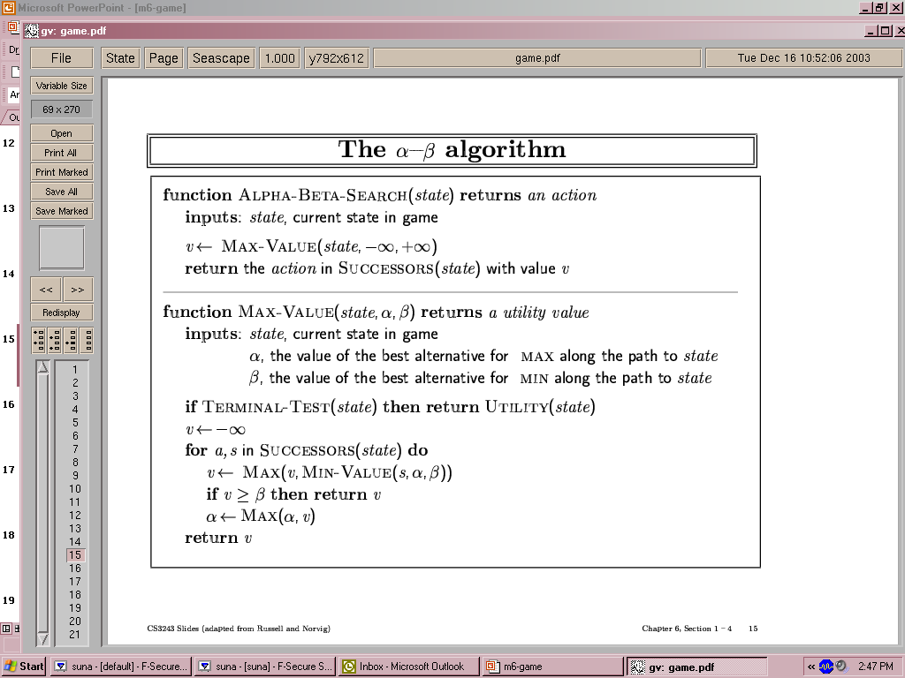
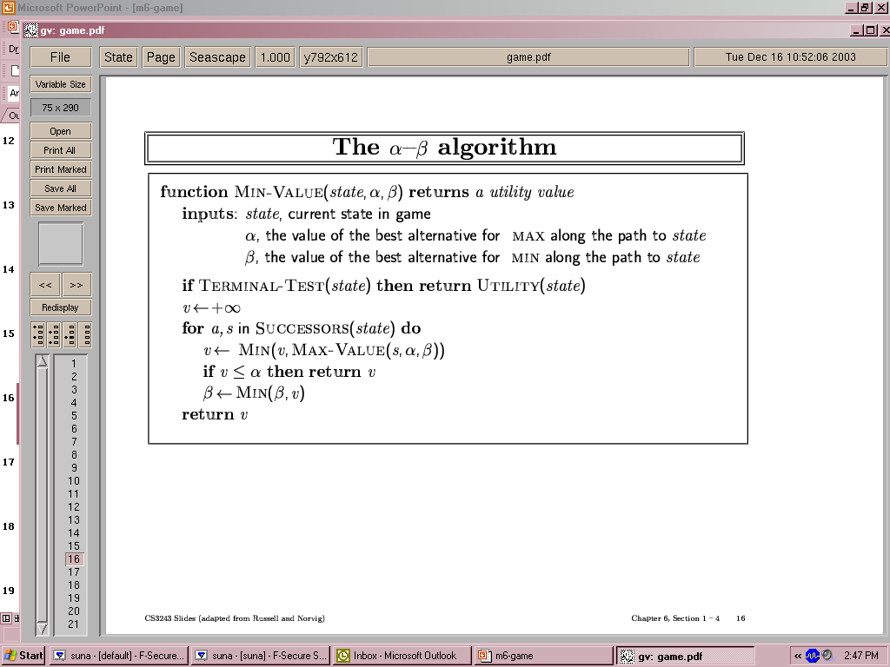
The α-β algorithm

Slide 32
Properties of α-β
Pruning does not affect final result
Good move ordering improves effectiveness of pruning
With "perfect ordering”, time complexity = O(b^{m/2})
→ doubles depth of search
A simple example of the value of reasoning about which computations are relevant (a form of meta-reasoning)

Slide 33

Questions

